Slide 1

First Estimator
House prices prediction model by Maria | Apostolis | Nikos

Slide 2


WHY?- Why did we develop the ML model?
Empowering a real estate company to make better, faster pricing decisions.
The real estate market is competitive and accurate pricing is crucial for success.
Brokers need a reliable starting point to estimate house prices quickly and effectively.
A machine learning model would be a solution that saves a lot of time, since it can predict a first estimation of each house’s price.

Slide 3
HOW?- How Did We Approach This?
We built a model based on the features brokers consider important.
Understanding the Data: Analyzed the dataset provided by brokers, focusing on key features influencing house prices (e.g., number of bedrooms, size).
Model Development:
We analyzed relationships between these features and historical house prices.
Built a predictive system to estimate prices based on new inputs.
Evaluation: Tested the model to ensure the estimates align closely with real market prices.

Slide 4

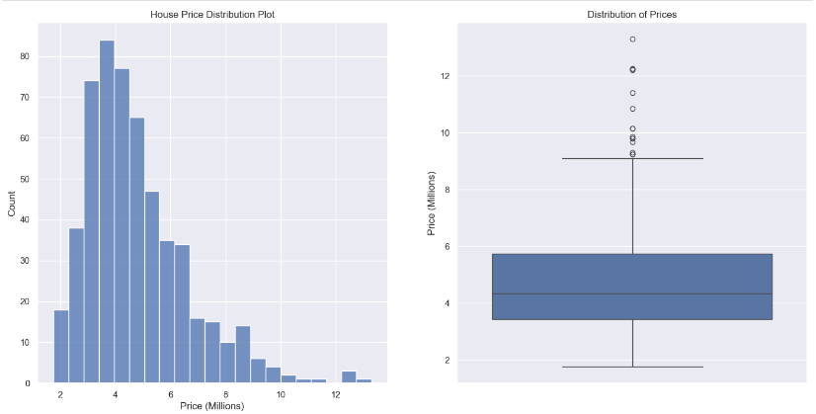
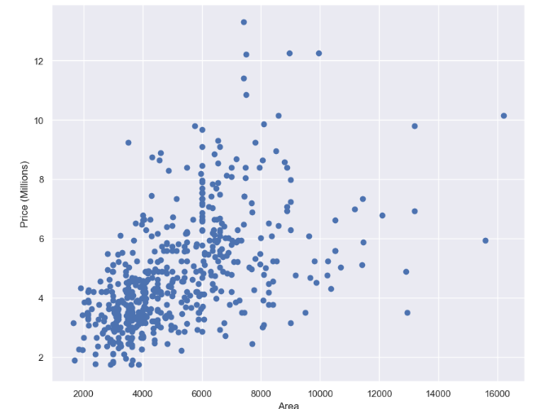
HOW?-Some graphs for better understanding

Slide 5

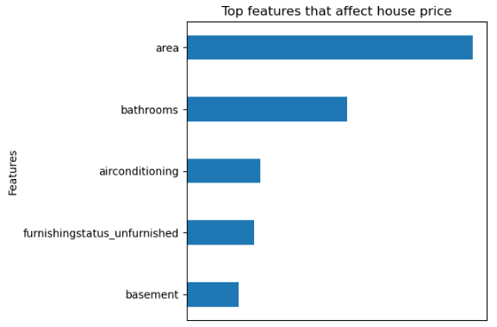
HOW - What Features Are Considered in the Model?
Features brokers should prioritize in pricing decisions.

Slide 6

HOW - How Does the Model Work?
Turning raw data into actionable insights.
The broker inputs a house’s features into the model.
The model analyzes these features based on patterns it learned from historical data.
The model provides a price estimate, acting as a starting point for brokers.
Features
Model analyzing..
Price Estimation

Slide 7
WHAT?- What did we achieve?
A tool that delivers reliable first estimations, with moderate to strong model reliability .
The model can predict house prices within a reasonable range of market values.
It complements brokers' expertise by offering a consistent, data-backed starting price.
Time Efficiency: Provides quick estimates, reducing manual analysis.

Slide 8

Improving the Model
To make the model even better, we need more detailed data.
Additional data could improve accuracy:
Neighborhood trends, such as upcoming developments
Market conditions, like seasonality or demand shifts
Crime rate
Kitchen, garden, pool, fireplace, etc.
Year built
Call to Action! Collaboration with the company to collect more features that will enhance our model.

Slide 9
Closing and Next Steps
Next Steps:
Collaborate with the company to gather more feature information.
Pilot the tool in a selected region, gather feedback, and improve.
Explore how this tool can integrate into brokers’ workflows seamlessly.

Slide 10


We’re excited to hear your feedback and work together to bring this tool to life!

